Slide 1
Mini Lesson 2: Writing Complete Sentences
Expressing Complete Thoughts

Slide 2
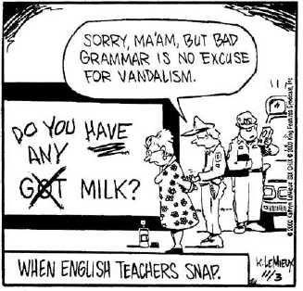

Slide 3
What does a sentence contain?
A sentence is a group of words that expresses a complete thought. Every sentence contains a verb, begins with a capital letter, and ends with either a period, a question mark, or an exclamation point.
NOT ALL GROUPS OF WORDS CAN BE CONSIDERED SENTENCES.

Slide 4
Phrases and Clauses
A phrase is a group of related words that does not contain a verb and therefore a phrase IS NOT A SENTENCE.
Clauses are groups of related words that have a subject and a verb and that form part of a sentence. There are two types of clauses: subordinate and principal.
Subordinate clauses ARE NOT SENTENCES because they do not express complete thoughts.
Principal clauses CAN BECOME SENTENCES WITH PROPER PUNCTUATION.

Slide 5
Examples of Phrases (no verb)
Under the sea
To the ends of the earth
Throughout time
In a matter of seconds

Slide 6
Examples of Subordinate Clauses (not complete thoughts)
As we watched
Because the weather was so bad
On the balcony
Speaking loudly

Slide 7
Examples of Principal Clauses (could be sentences with proper punctuation)
Let go of my nose (just add an exclamation point)
What is that (just add a question mark)
To err is human (just add a period)

Slide 8
Practice: tell whether each of the following is a phrase, a subordinate clause, or a principal clause
1. around the back 7. speaking softly
2. that I loved once 8. give me a call
3. Irina fixed 9. legends that reflect the beliefs
4. if he calls 10. rehearse your interviewing skills
5. it was the seafood
6. never in a million years

Slide 9
Answers
1. Phrase 7. subordinate clause
2. subordinate clause 8. principal clause
3. subordinate clause 9. subordinate clause
4. subordinate clause 10. principal clause
5. principal clause
6. phrase

