Slide 1
Mini Lesson 4: Sentences Continued…
Fragments and Run-On Sentences

Slide 2
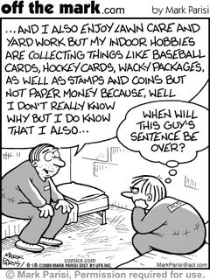

Slide 3
What is a sentence fragment?
A sentence fragment is a group of words that is punctuated like a sentence but the words do not complete an idea. A fragment can be corrected by adding the missing words.

Slide 4
Example of a fragment
Wandering around downtown.
We are left wondering WHAT happened while wandering downtown or WHO was wandering. Therefore additional words are needed to complete the idea.

Slide 5
What is a Run on Sentence?
A run on sentence is when two or more sentences are written as one.
Run-ons occur when writer includes too many thoughts in one sentence. A run-on sentence also occurs when a writer puts a comma in the place of a period, colon, or semicolon.

Slide 6
Example of a Run On
He captured Sarah and held her for ransom, he promised to release her if her father would fork over his antique car collection.
This run-on can be corrected by substituting the comma with a period.

Slide 7
Practice-Tell whether each of the following is a fragment, run-on, or complete sentence.
1. The Cambrian period of geology began around 570 million years ago.
2. Lasted for about 70million years.
3. For millions of years, only very simple life forms such as worms and anemones.
4. Then a huge explosion of animal evolution took place, in the space of a mere 10 million years virtually all the different phyla, or body types, came into being.

Slide 8
Answers
1. complete sentence
2. fragment
3. fragment
4. Run-on

